Slide 1

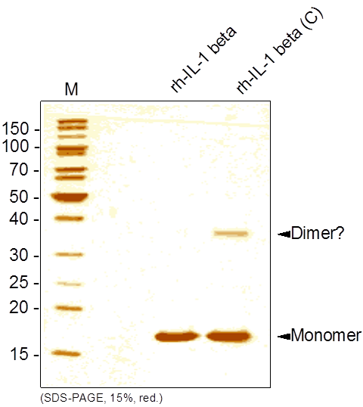
Reliatech GmbH
Recombinant human IL-1 beta
(Cat #400-002)
Fig. 1: SDS-PAGE analysis of recombinant human IL-1 beta derived from E. coli. Samples were loaded in 15% SDS-polyacrylamide gel under reducing conditions and stained with Silver stain.
http://www.reliatech.de / orders@reliatech.de

